Slide 1
Physical examination of patients with Urinary system diseases

Slide 2
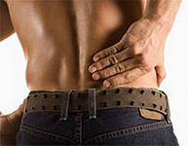
Complaints of patients with urinary system diseases
Main complaints
Pain in lumbar region
Urination disturbances (dysuria)
Renal edema (nephredema)

Slide 3
Complaints of patients with urinary system diseases
Additional complaints
Headache
Dizziness
Visual impairment (vision disorder)
Pains in cardiac region
Dyspnea
Loss of appetite (anorexia)
Nausea
Vomiting
Fever

Slide 4
Pains in urinary system diseases
Pathology Location / Irradiation
Urinary bladder suprapubic
Kidneys lumbar region
Ureter along ureters
Urolithiasis irradiation down to perineum

Slide 5
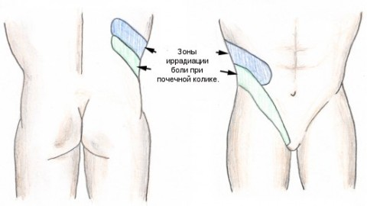
Pains in urinary system diseases
Location / Irradiation

Slide 6
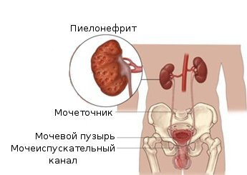
Character of pains in urinary diseases
Dull & boring pain in lumbar region
Possible reasons:
- Acute glomerulonephritis
Pararenal abscess
«congestive kydney»
- Acute pyelonephritis
- Chron. glomerulonephritis (rarely)

Slide 7
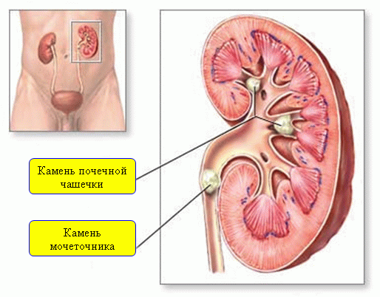
Character of pains in urinary diseases
Sharp acute unilateral pains
Possible reasons:
Renal infarct (hours, days),
Acute pyelonephritis (prolonged)
Renal colic (frequently unilateral)
Possible reasons:
Obstruction of ureter by stone
Ureteric kink

Slide 8
Conditions for starting & elimination of pains in urinary diseases
Pain in renal colic
relieve after injection of atropine, application of hot-water bag, warm bath
Pain in movable kidney
relieve in change of body’s position
Pain in acute paranephritis
decrease after application of ice pack on loin, analgesics and NSAIDs

Slide 9
Change of diuresis volume
ml
> 2000
3000
2000
about 1500 - 2000
1000
< 500
0
0
norm
polyuria
oliguria
anuria
Big liquid consumption,
diabetes mellitus,
diabetes insipidus
Small liquid consumption,
glomerulonephritis,
nephrotic syndrome,
renal insufficiency
Terminal stage of
renal insufficiency
14

Slide 10
Dysuria (1) Change of daily diuresis volume
Dysuria Causes
Polyuria - rich drinking of liquids
- removal of edema
- diabetes mellitus
- diabetes insipidus
- chronic nephritis
- nephroarteriosclerosis
Oliguria - limitation of drinking of liquids
- dry & hot air
- enforced sweat secretion - vomiting, profuse diarrhea
- acute nephritis
- acute kidneys dystrophia

Slide 11
Dysuria (2) Change of daily diuresis volume
Dysuria Causes
Anuria - acute nephritis
- nephronecrosis
- incompatible blood transfusion
- heavy heart failure
- shock
- large hemorrhage
- obstruction by a stone
- edema of mucous urinary tract
germination by a tumor
Ischuria - injury of a spinal cord

Slide 12
Dysuria (3) Change of a rhythm of a diuresis
Reasons Dysuria
Pollakiuria - plentiful drink of liquid
- cooling of body
- cystitis
Isuria - chronic renal failure
Nocturia - cardiac decompensation
- terminating stage of chronic kidney diseases

Slide 13
Disuria (4)
Change of density of urine
Reasons Dysuria
Isosthenuria,
Hyposthenuria - nephrosclerosis
Strangury - diseases of a bladder and an urethra

Slide 14
Anamnesis of illness at patients with urinary system diseases
Pathology
Acute GN
Renal pathology
Intoxications
Character of a current
Reasons
Angina, scarlet fever, otitis, etc.
In the past – nephrite, a pyelitis, cystitis, dysurias, hypostases, bloody urine, increase of a BP, "renal colic“
Household, production; medicinal preparations
Gradual – CGN, an amyloidosis, a nephrotic syndrome
Recurrence – chron. pyelonephritis, CGN

Slide 15
Anamnesis vitae at patients with urinary system diseases
The factors causing kidneys & urinary system disease
Overcooling
Disease of genitals
Tuberculosis
Rheumatic diseases
Diabetes mellitus
Chronic purulent diseases
Physical overwork, overexertion
Genetic predisposition
Kidney and urinary system operations in the past
Gynecologic anamnesis

Slide 16
General examination at patients with urinary system diseases
Position of the patient
Active - in an incipient state of an illness
Passive - at an uremic coma
Forced - at a paranephritis,
to renal colic

Slide 17
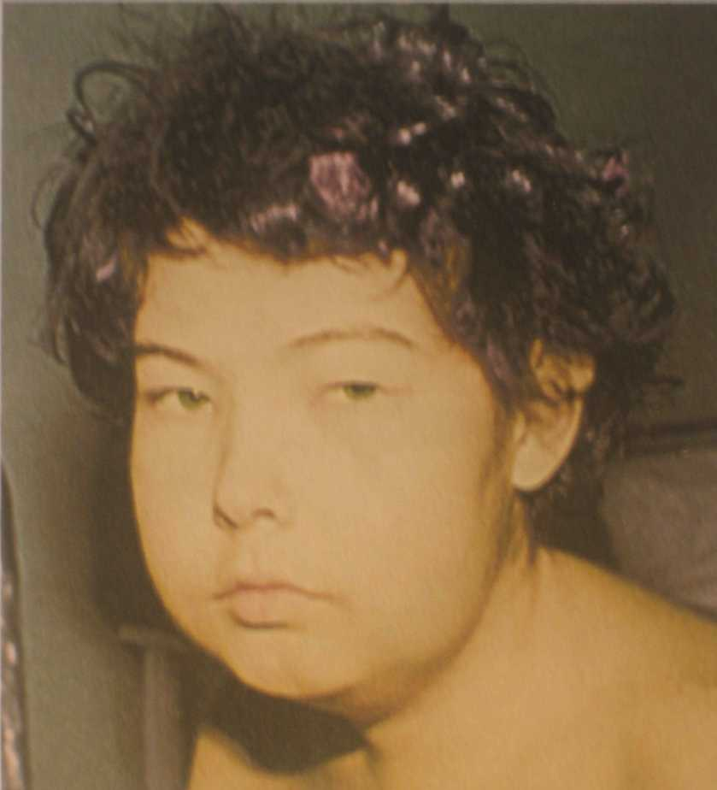
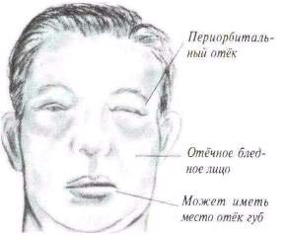
Renal edema
Facies nephritica – pale face, bloated, with the swelled up a little edematous eyelids and reduced palpebral fissures

Slide 18
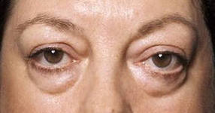
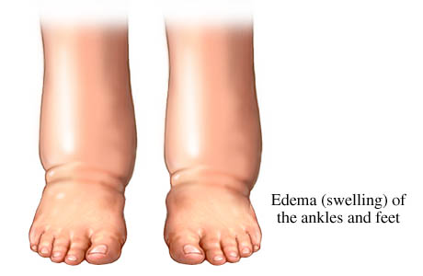
Renal edema

Slide 19
General examination at patients with urinary system diseases
Examination of skin
Color - paleness (spasm of arterioles, anemia)
- wax skin (amyloidosis, lipoid nephrosis)
Foettor uremicus – the ammonia smell proceeding from a mouth and from the patient's skin

Slide 20
General examination at patients with urinary system diseases
Examination of a stomach and lumbar area
Symptoms Reason
Swelling of lumbar area
on affected side - paranephritis
Protrusion of abdominal wall
on affected side - kidney tumor
Protrusion in the suprapubic
areas - ischuria at adenoma or prostate cancer

Slide 21
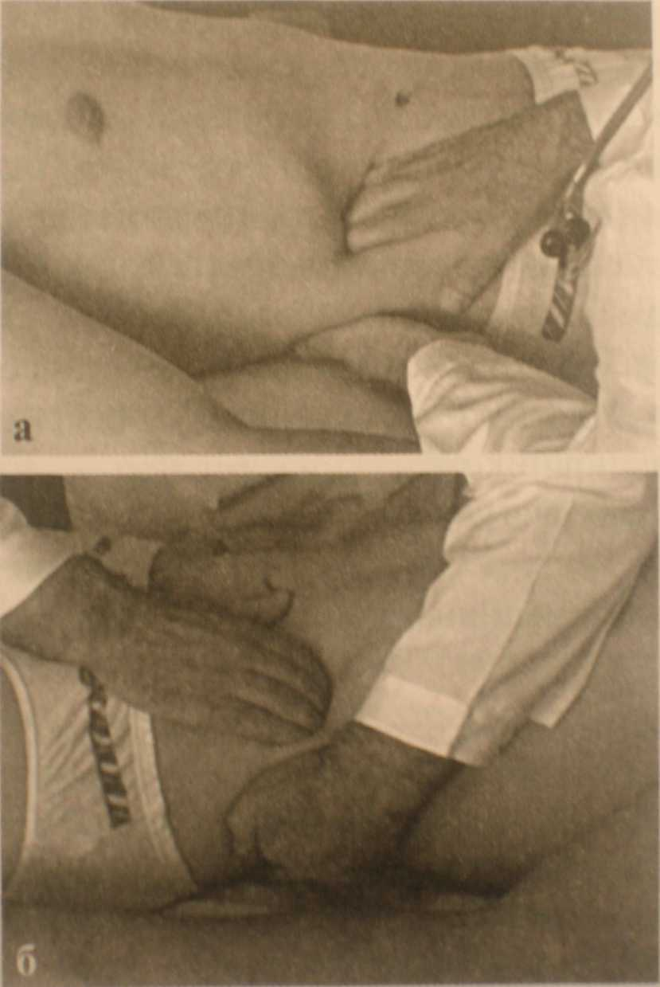
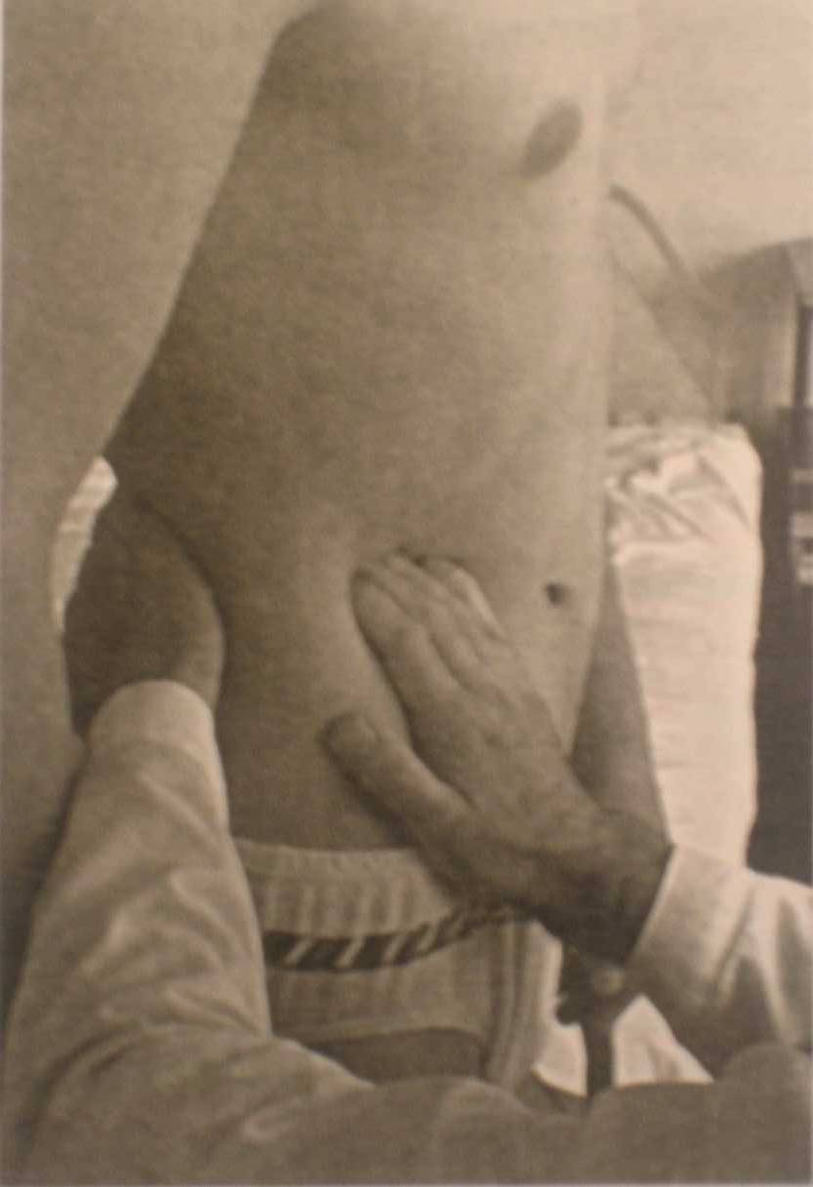
Palpation of kidneys
Palpation of kidneys in horizontal position of the patient
Palpation of kidneys in vertical position of the patient

Slide 22
Palpation of kidneys
Palpatorny definition of a kidney
Physiological reasons
- weakening of a preulum abdominale
- fast weight loss
Pathological reasons
- omission of kidneys
- kidney cyst
- kidney tumor

Slide 23
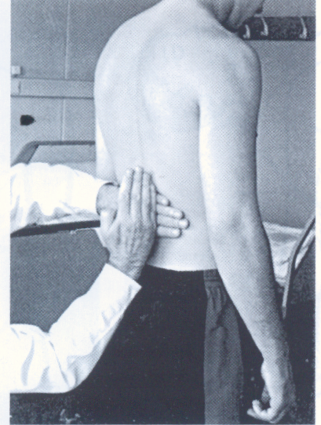
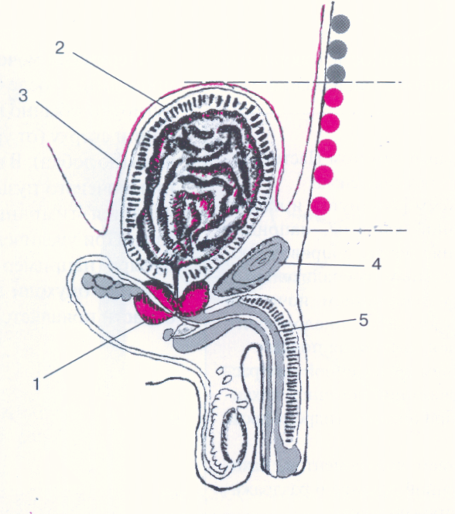
Percussion of kidneys and bladder
Percussion definition of a bladder (scheme)
Effleurage symptom on area of kidneys

Slide 24
Percussion of kidneys
Positive symptom of effleurage
Reasons: - urolithiasis
- paranephritis
- inflammation in pelvis
- myositis
- radiculitis
Percussion of a bladder
Reason: - overfilling of a bladder at adenoma or a prostate cancer

Slide 25
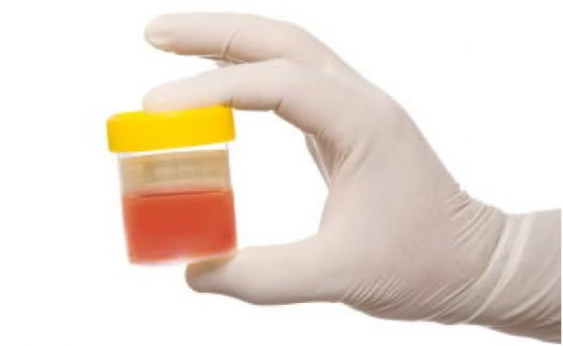
Laboratory tests in urinary system investigation
Urine research
Assessment of physical & chemical properties of urine, deposit microscopy
- Urine analysis
The quantitative definition of
corpuscules in urinary sediment
- Nechiporenko's test
- Addis-Kakovsky's test

Slide 26
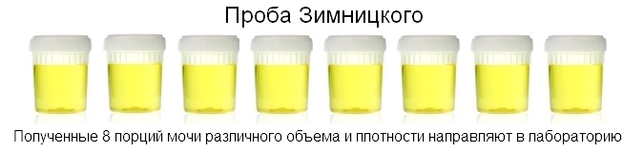
Research of function of kidneys
Zimnitsky's Test
Test on concentration
Test on dilution
Reberg's Test

Slide 27
Laboratory tests in urinary system investigation
Biochemical blood analysis
Purpose Research
Assessment of function - rest nitrogen
of kidneys - urea
- creatinine

Slide 28
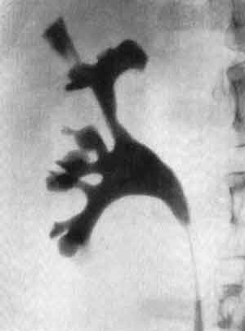
Instrumental research techniques of urinary system
Radiological methods
- Plan radiography of kidneys
- Excretory urography
- Renography
- Computer tomography (CT)

Slide 29
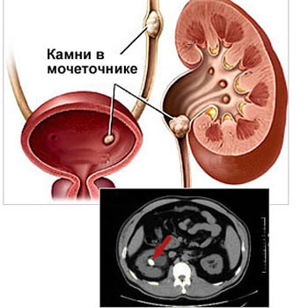
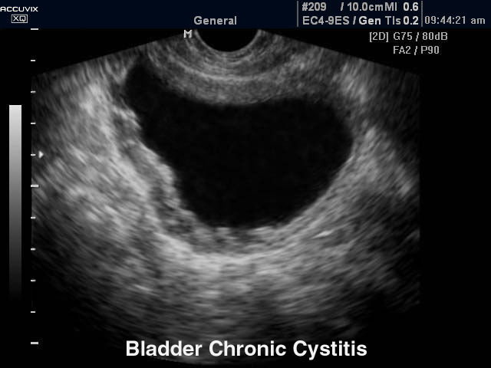
Ultrasound technics

Slide 30
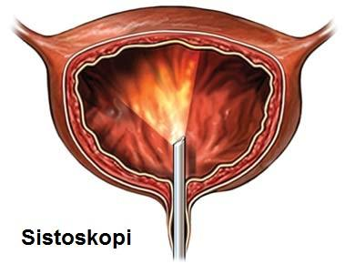
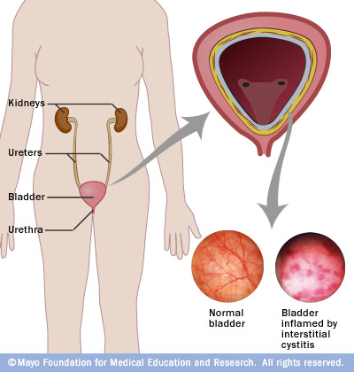
Endoscopic methods
Cystoscopy

Slide 31
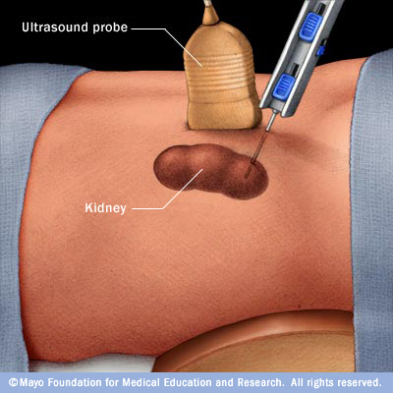
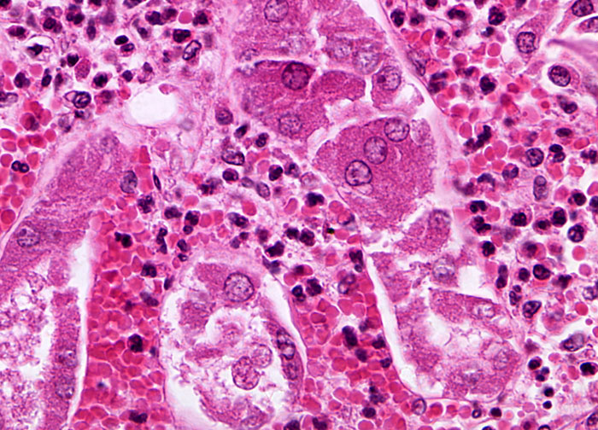
Morphological methods
Biopsy of Kidneys

Slide 32
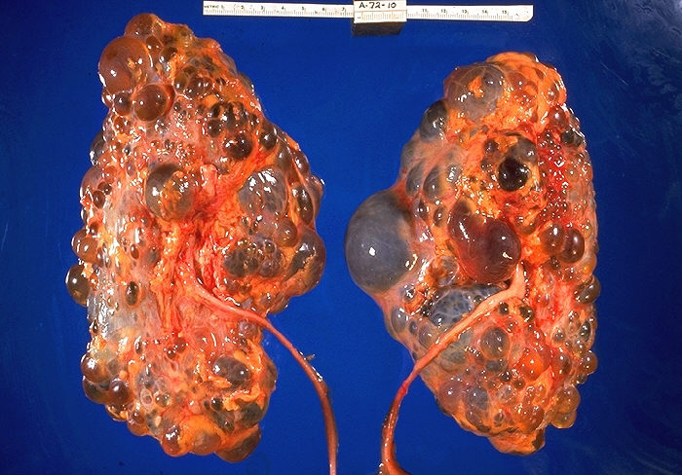
Thanks for your attention!

